Slide 1

FreeGX
Freelancing Platform with project management
Saad Ur Rehman Abdul Shakoor Mohammad Anas
19k-0218
19k-1373
19k-1499
Supervisor: Sir Ubaid Chawala
Co-Supervisor: Sir Sayed Yousuf

Slide 2

INTRODUCTION
FreeGx is a web application where you can do freelancing with ease and search for seller with extraordinary services to provide you with the best quality experience.

Slide 3



Problems with other freelancing platforms?
Absence of Project Management Tool Progress report cannot be created No concept of co-workers
The project cannot break down ( NO WBS ) Project statistics unknown

Slide 4


How to Resolve these Problems ?
We will provide a platform to work in a collaborative environment.
We will allow the seller to add multiple co- workers to increase the productivity of the assigned task
The system will help to create a work breakdown structure to well organize the projects.
The system will maintain a weekly or monthly progress reports between sellers and clients

Slide 5

FINDINGS
WE HAVE CAREFULLY OBSERVED THE CORE REQUIREMENTS OF WHAT USER NEEDS. 70% OF PEOPLE FOUND OUR IDEA WILL BE HELPFUL FOR THEM

Slide 6

Yes 19.1%
Restrict gigs 2.1%
Not at all
Pause account 19.1%
Post to facebook 25.5%
Fair
Good
Excellent
No 80.9%
Outsource to whatsapp 53.2%
How Freelancers Handles Multiple Project?
0 5 10 15
Freelancers Review on co-worker system
Is there any project management tool provided by your choosen platform?
30
20
89%
10
0
Calls
Chat
Online Meeting
What do you say when a client asks for the project state?
Freelancer want to work with multiple co-workers as a team

Slide 7
MAIN FEATURES
Multiple Co- workers
WBS
Gigs LifeCycle
Project Placement
Task Distribution
Progress Report
Project Statistics
Chat
File Sharing
Payment/Biling
Analytics

Slide 8
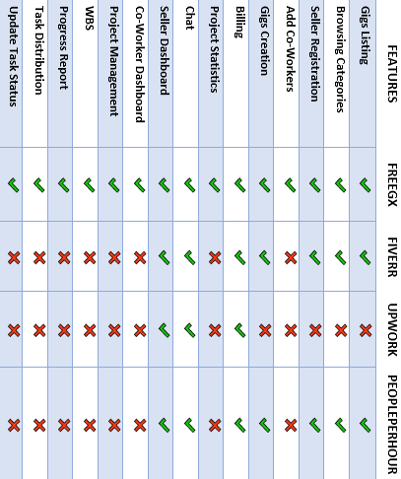
FreeGX versus Others

Slide 9
METHODOLOGY

Slide 10

AGILE MODEL
Our requirements may change so we are using Agile approach which will help us to build a software with an interative and incremental development.
Once the work begins, teams’ cycle through a process of planning, executing, and evaluating
The Product undergoes testing phase to make the product free from errors and bugs.

Slide 11
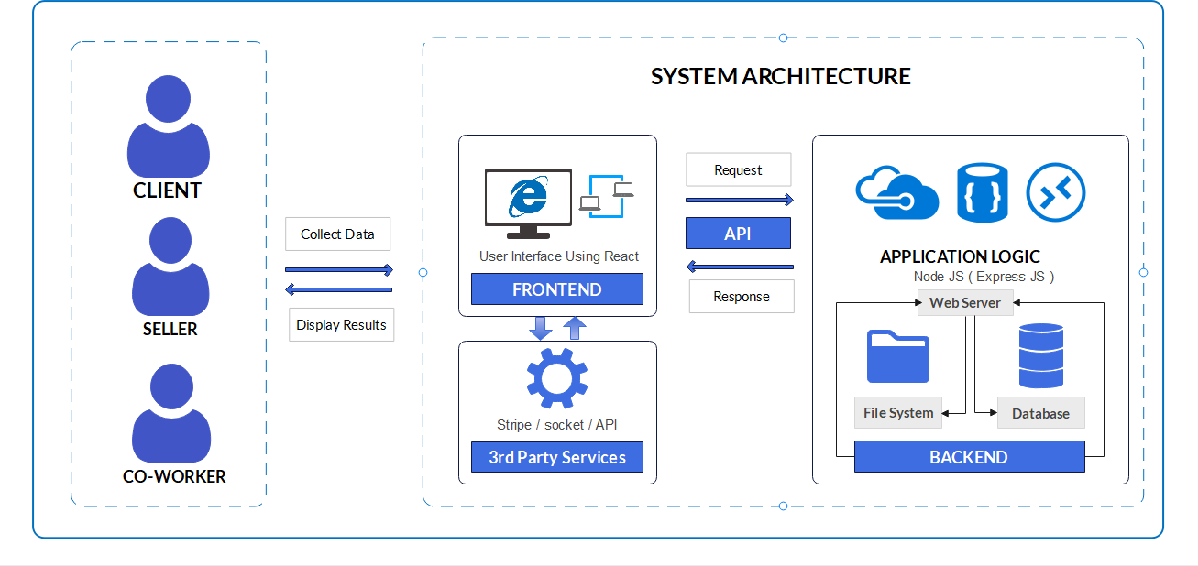

Slide 12
GANTT CHART

Slide 13
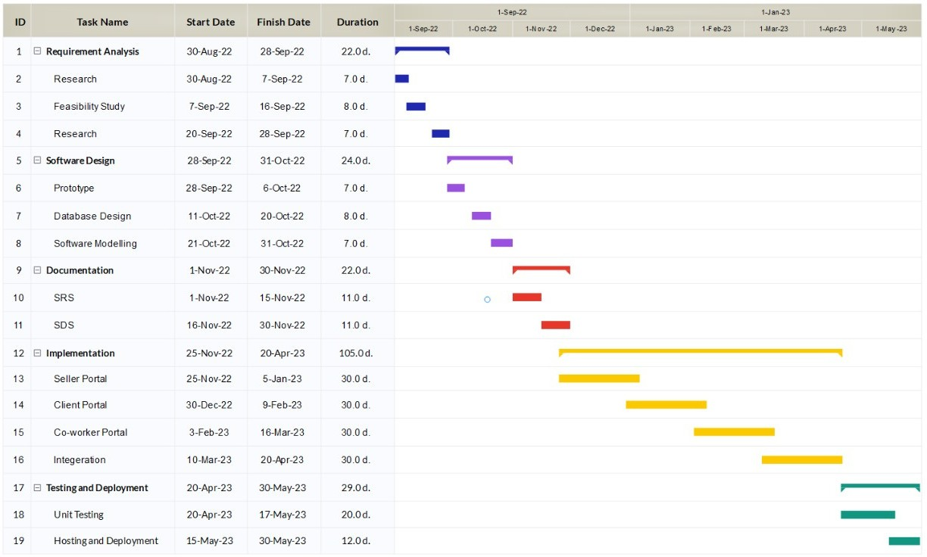

Slide 14


Tools & Technologies
1
ReactJs
2
NodeJs/ExpressJs
3
MongoDB
4
5
PostgreeSQL
Heroku

Slide 15
Deliverable Project
What do we plan to deliver in the project?
FYP1
Requirement Analysis Design Phase
SRS and SDS
Architecture & Infrastructure setup Implementation Phase (Seller Portal)
FYP2
Implementation Phase (Client Portal) Implmenetation Phase (Co-Worker Portal) Software Testing
Finishing FYP touches Testing and Deployment

Slide 16



Thank you
Feedback/suggestions as call to action - “what would you do if you were building this project?”
Q/A session

